Slide 1
Guessing the context
 | What I think ....
Where are we?
Who is in the story?
What is happening now?
What is going to happen?

Slide 2
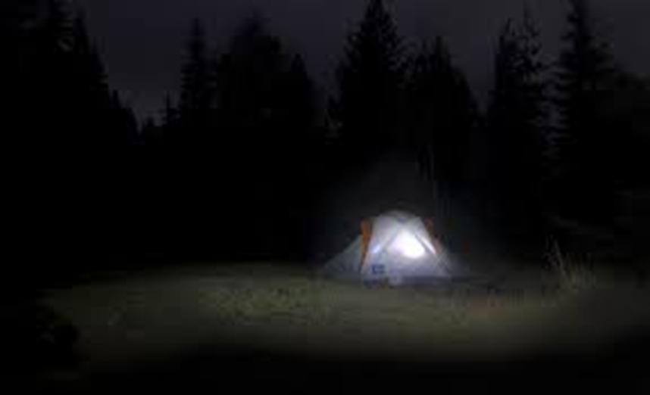

Slide 3
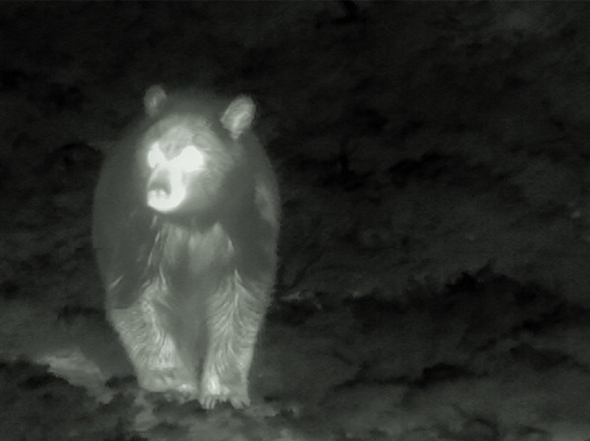

Slide 4
Imagine it’s you in the tent ...
Think of 4 actions you would take from crouching inside to checking whether it really was a bear outside
Actions
1.
2.
3.
4.

Slide 5
Imagine it’s you in the tent ...
Think of 4 actions you would take from crouching inside, to checking whether it really was a bear outside
Actions | How did I perform the action?
1.
2.
3.
4.

Slide 6
How did he perform the actions?
Match the verbs in the left column to a suitable adverb in the right column
Actions | How did he perform the action?
1. dashing around | instinctively
2. reached | frantically
3. climbed | cautiously
4. threw | carefully
5. shouted | nervously

